Slide 1
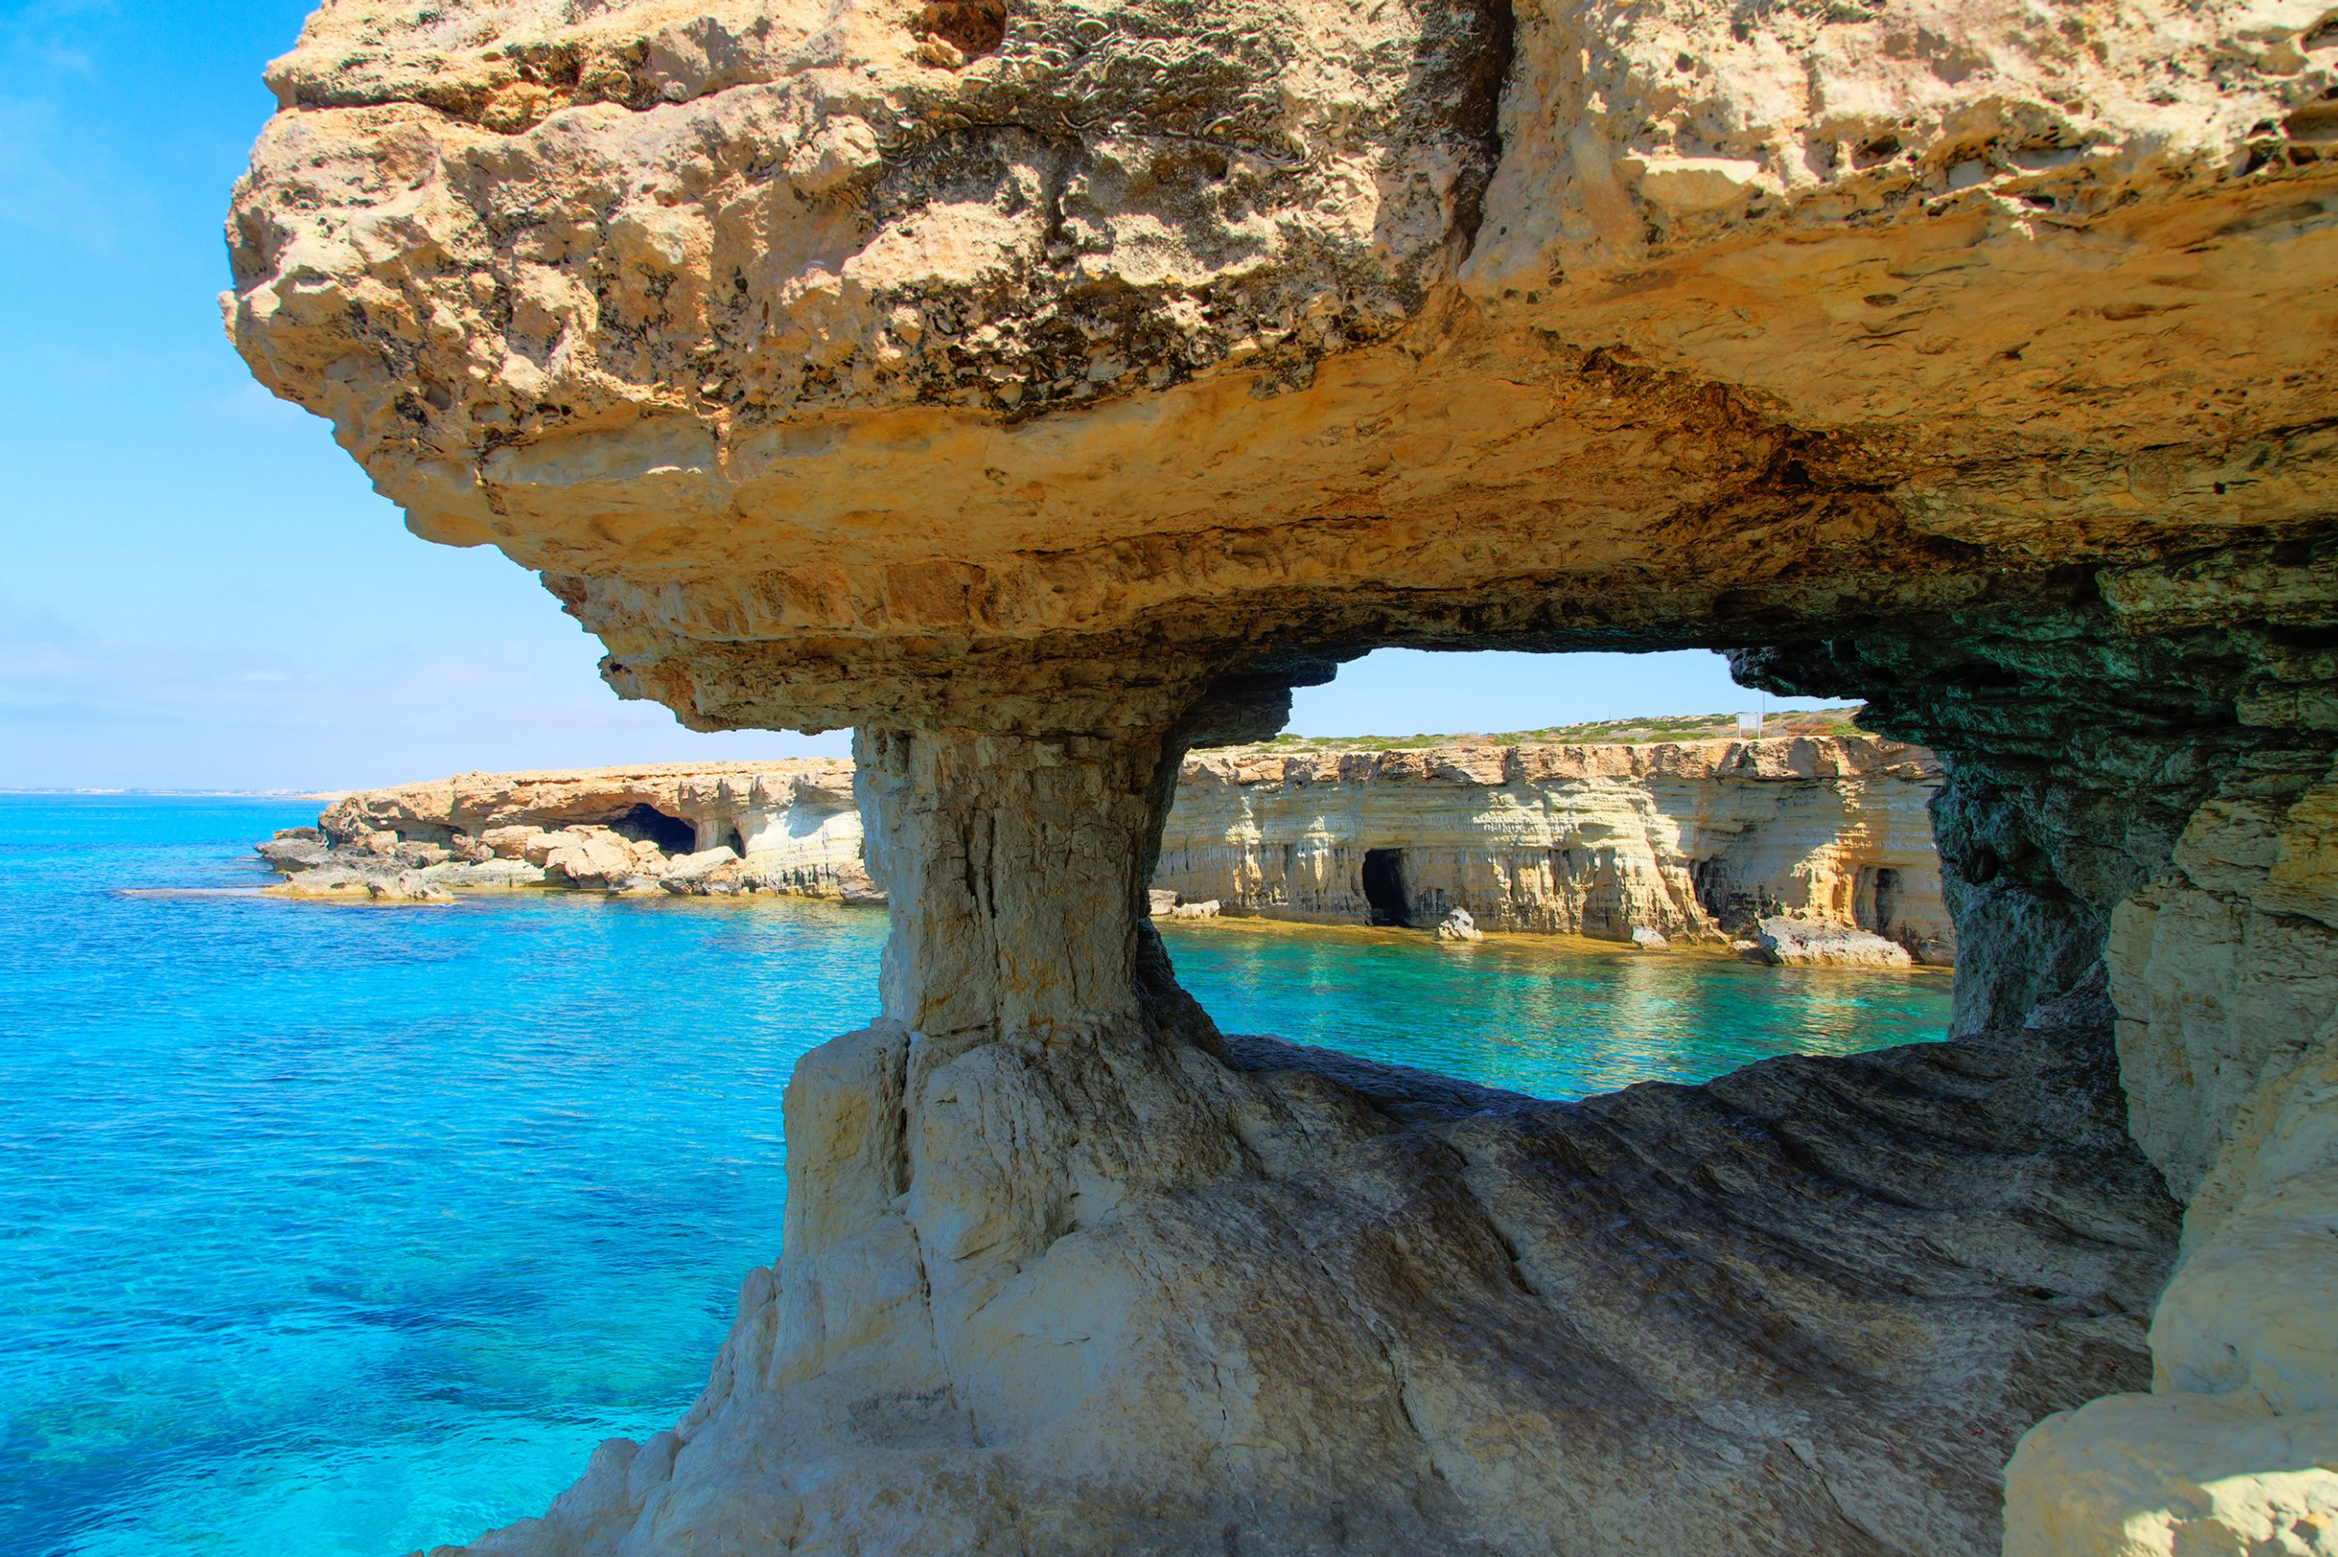
Geo tourism in Cyprus
Notes:
Cyprus Travel Advice | Travel Guide & Information | Red Savannah
Ayia Napa Sea Caves | Cyprus Island

Slide 2
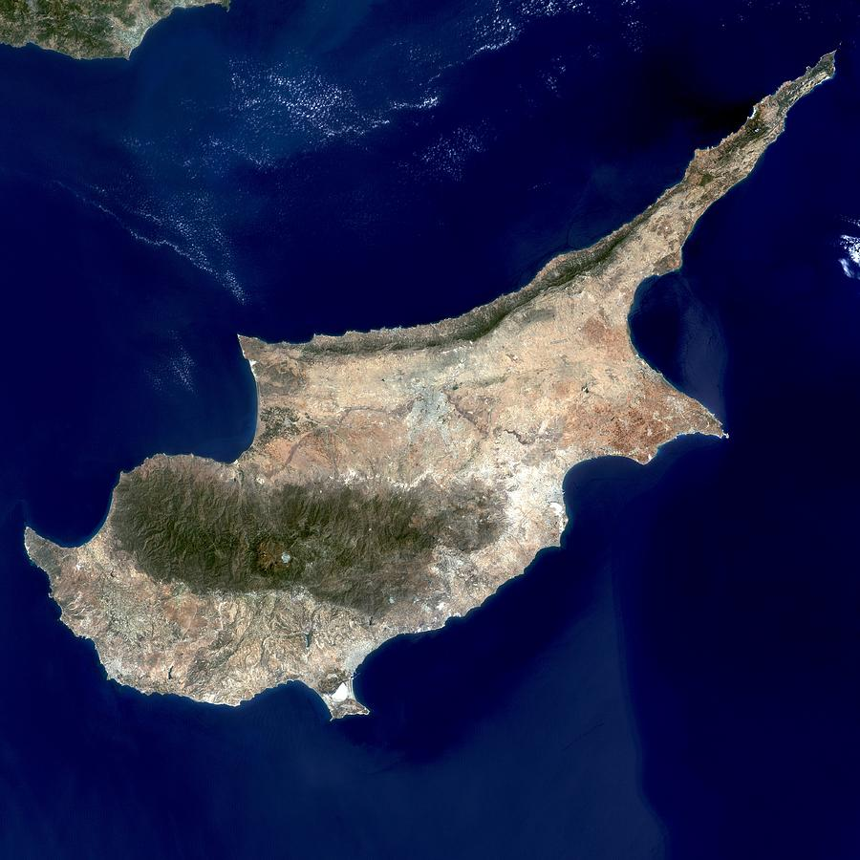
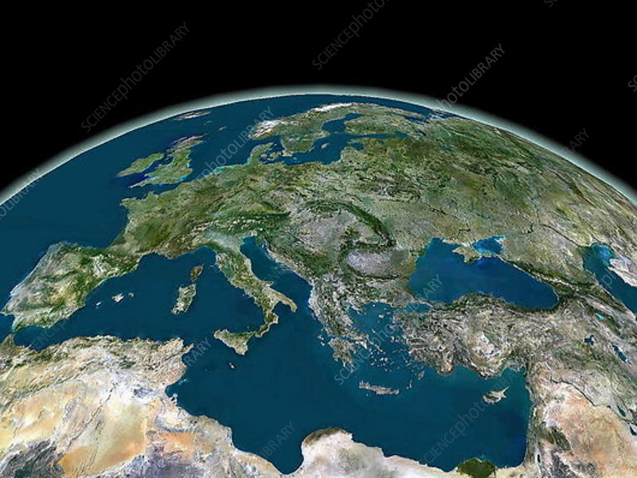
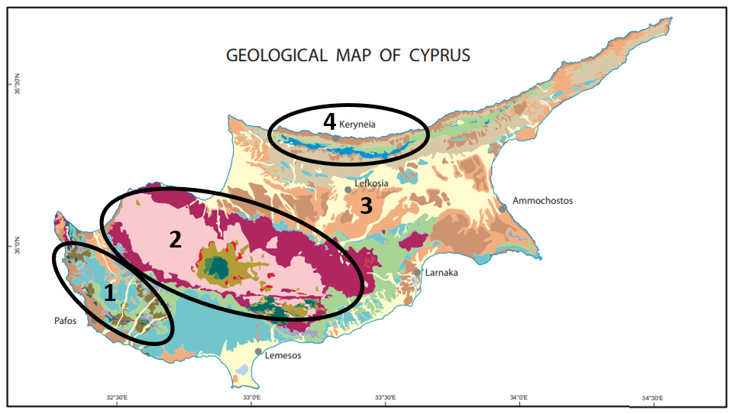
Geology of Cyprus
Cyprus is the third largest island of the Mediterranean Sea, with rich culture, history, wildlife and geology
Earliest human activity on the island dates back to 10th millennium BC. Through overseas trade, the island has given its name to the Latin word for copper through the phrase aes Cyprium: “metal of Cyprus”
Has 4 main geological zones:
Mamonia complex
Troodos ophiolite
Sedimentary formations
Keryneia Zone
Notes:
Cyprus Satellite Map - Bing images
Geological Survey Department | Home Page (moa.gov.cy)

Slide 3
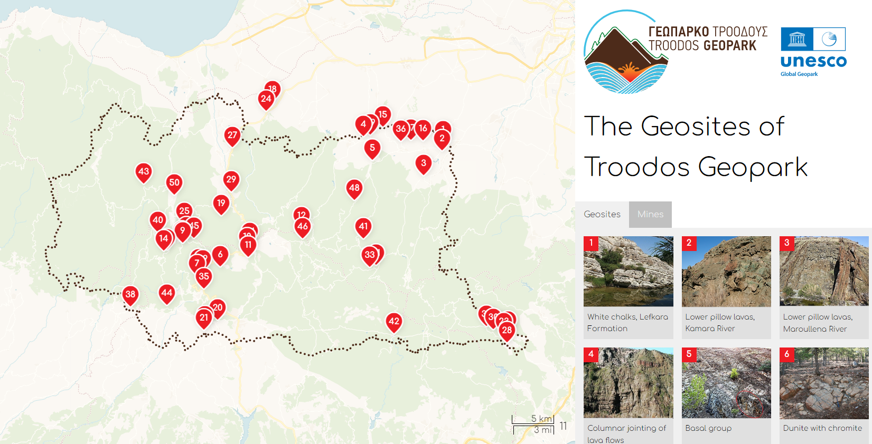
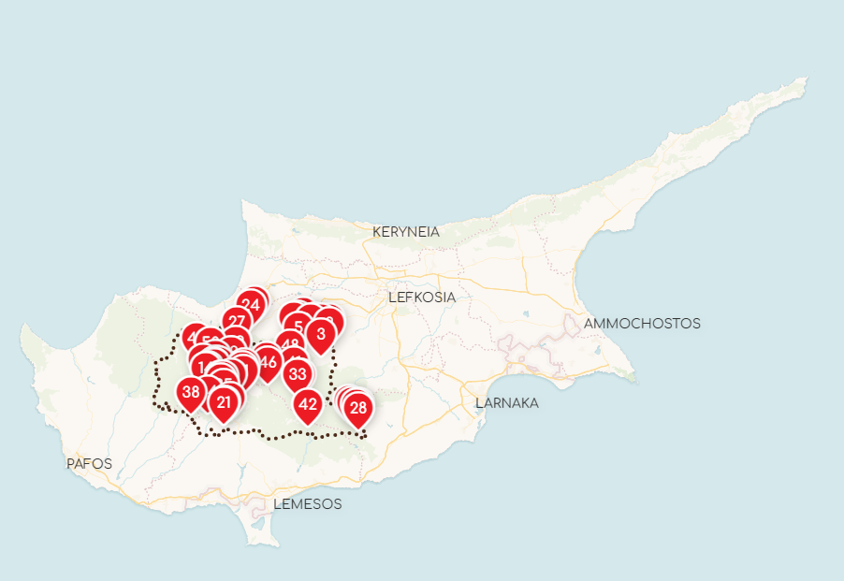
1. Troodos Geo Park: Geo Sites “Oceanic whispers on high altitude”
Designated as a UNESCO Global Geo Park in 2015
The Troodos ophiolite is internationally known amongst geoscientists for its stratigraphic completeness and well-preserved and well-exposed plutonic, intrusive, volcanic rocks and chemical sediments.
Formed 92 million years ago in the Neotethys Ocean by seafloor spreading above a subduction zone, it was uplifted and placed in a dome structure by the collision between the Eurasian and African plates.
Offers a large number and variety of geo sites and mines to visit
Notes:
TROODOS UNESCO GLOBAL GEOPARK (Cyprus)
The Geosites of Troodos Geopark (prettymap.gr)

Slide 4
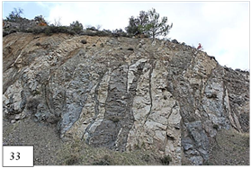
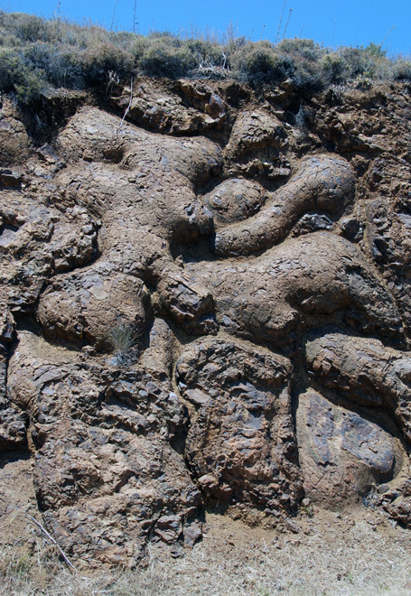
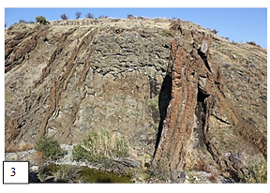
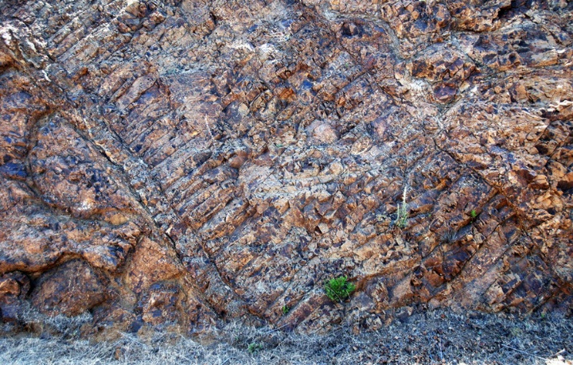
1. Troodos Geo Park: Geo Sites “Oceanic whispers on high altitude”
The ophiolite is a fragment of a fully developed oceanic crust, consisting of plutonic, intrusive and volcanic rocks and chemical sediments. Geo sites include:
asbestos mine in the serpentinite
chromite mining galleries in the dunite
ancient copper slag heaps around the copper mines in the pillow lavas
extensive parallel dyke landscapes
spreading center graben valleys
fossilized transform faults
Geo sites of the Troodos Geo Park constitute an important geodiversity, with significant contributions to the development of plate tectonic and ocean spreading theories as we know it today.
Plagiogranite in diabase dykes with magma intrusion
Lower pillow lavas with near vertical dykes
Exposed pillow lavas
Exposed dyke intrusion
Notes:
The Geosites of Troodos Geopark (prettymap.gr)
Cyprus Mountains (8 pages): I Troodos - fergusmurraysculpture.com

Slide 5
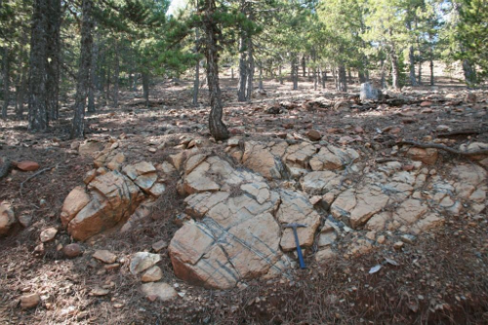
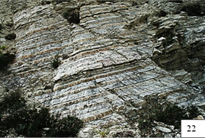
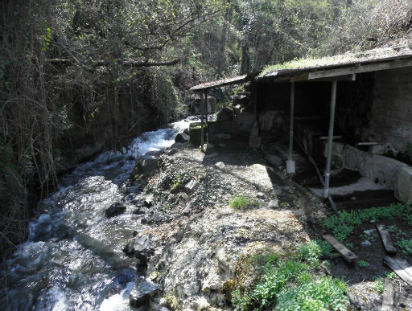
1. Troodos Geo Park: Geo Sites (Examples) “Oceanic whispers on high altitude”
Dunite with chromite (1): A dunite body in harzburgite with a distinctive occurrence of banded chromite (schlieren).
Bedded chalks with cherts (2): The influx of foraminifera and radiolarian rich calcilutites within a pelagic carbonate slope-basin setting near the carbonate compensation depth (CCD), formed both chalk and chert deposits during Early to Middle Eocene period (56-41 MYA).
The Sulfur springs of Kalopanagiotis (3): These 11 springs along the river valley are a unique phenomenon, not found elsewhere on the island. The therapeutic properties of the spring waters were known since antiquity.
1
2
3
Notes:
The Geosites of Troodos Geopark (prettymap.gr)

Slide 6
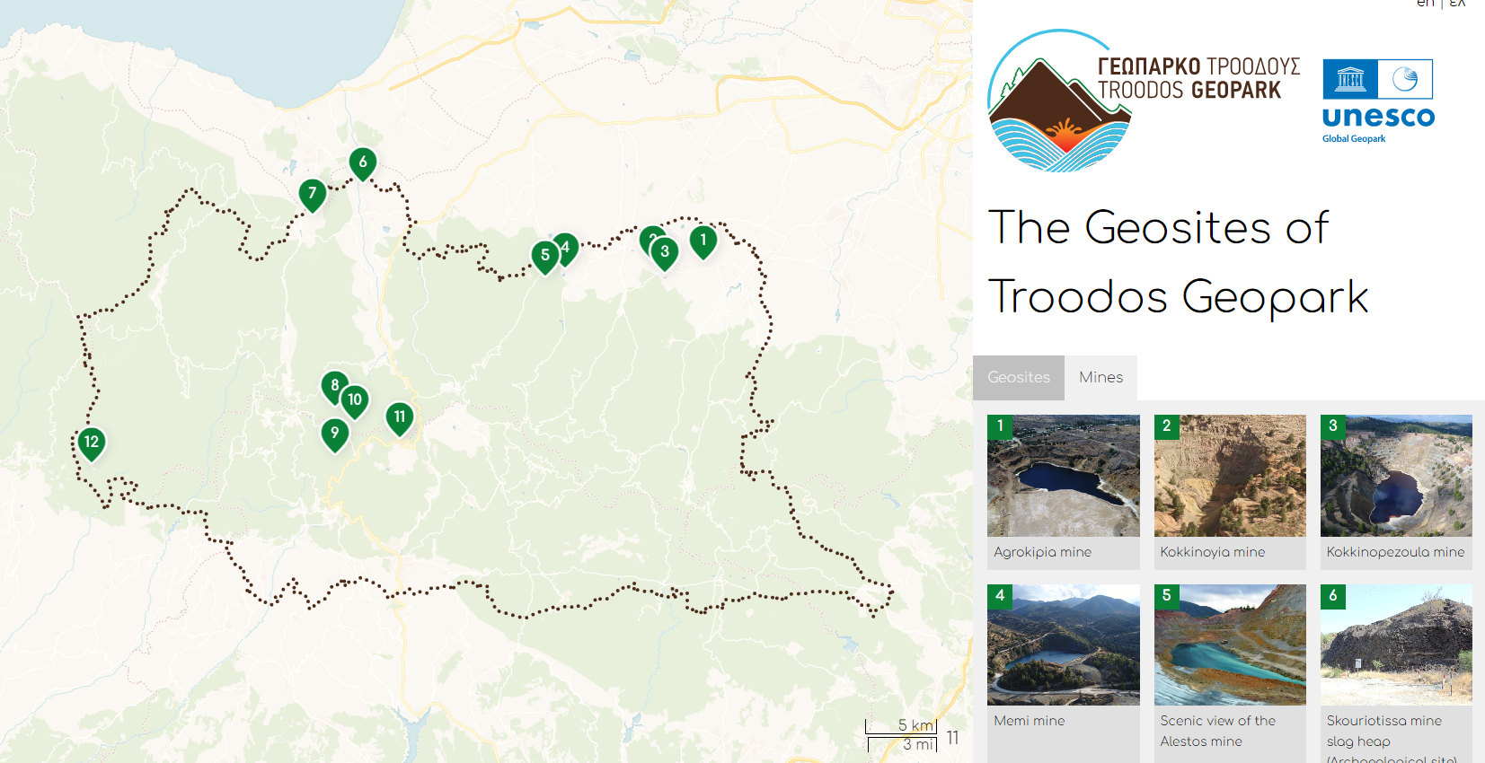
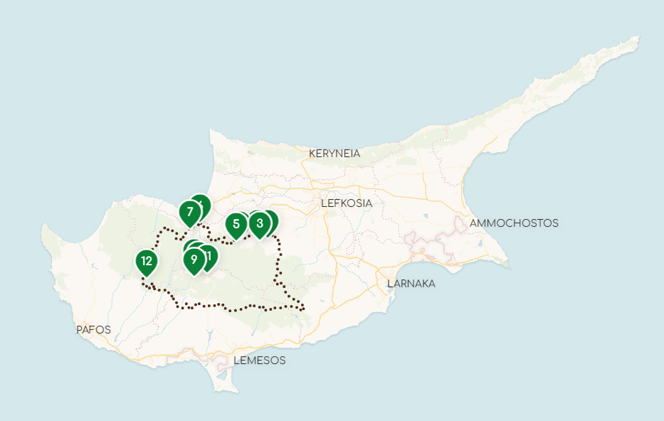
2. Troodos Geo Park: Mines “Oceanic whispers on high altitude”
The Troodos UNESCO Global Geo Park includes 12 mining sites that had been in use during various parts of history
Asbestos and umber were exploited since antiquity but it was the production and trade of copper from the Cyprus-type massive sulphide deposits that made Cyprus synonymous with copper.
In addition to copper and sulfur, there are also chromite and asbestos mines. The Asbestos mine is the biggest deposit of chrysotile asbestos in Europe.
Notes:
The Geosites of Troodos Geopark (prettymap.gr)

Slide 7
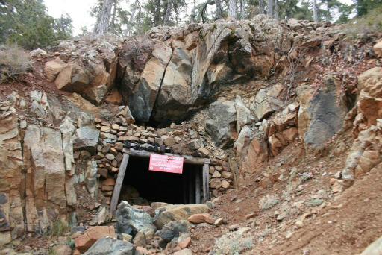
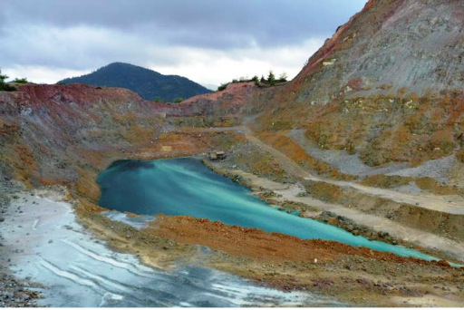
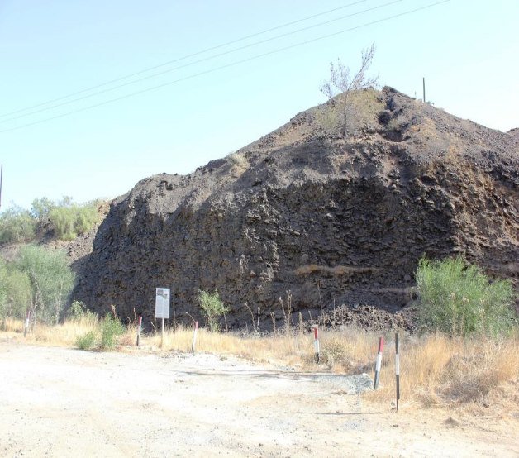
2. Troodos Geo Park: Mines “Oceanic whispers on high altitude”
Examples of mine sites situated within the Troodos UNESCO Geo Park include:
A chromite mine (Hadjipavlou mine)
Skouriotissa mine slag heap (Archaeological site)
The ancient Cypriots were experienced miners and skilful metallurgists and they discovered almost all copper ore bodies which have been exploited in modern years. The largest slag heap, (2,000,000 tons), is the remarkable waste of the metallurgical treatment and is dated since the Early Byzantine period (4th - 7th centuries A.D.).
A copper mine (Alestos mine)

Slide 8
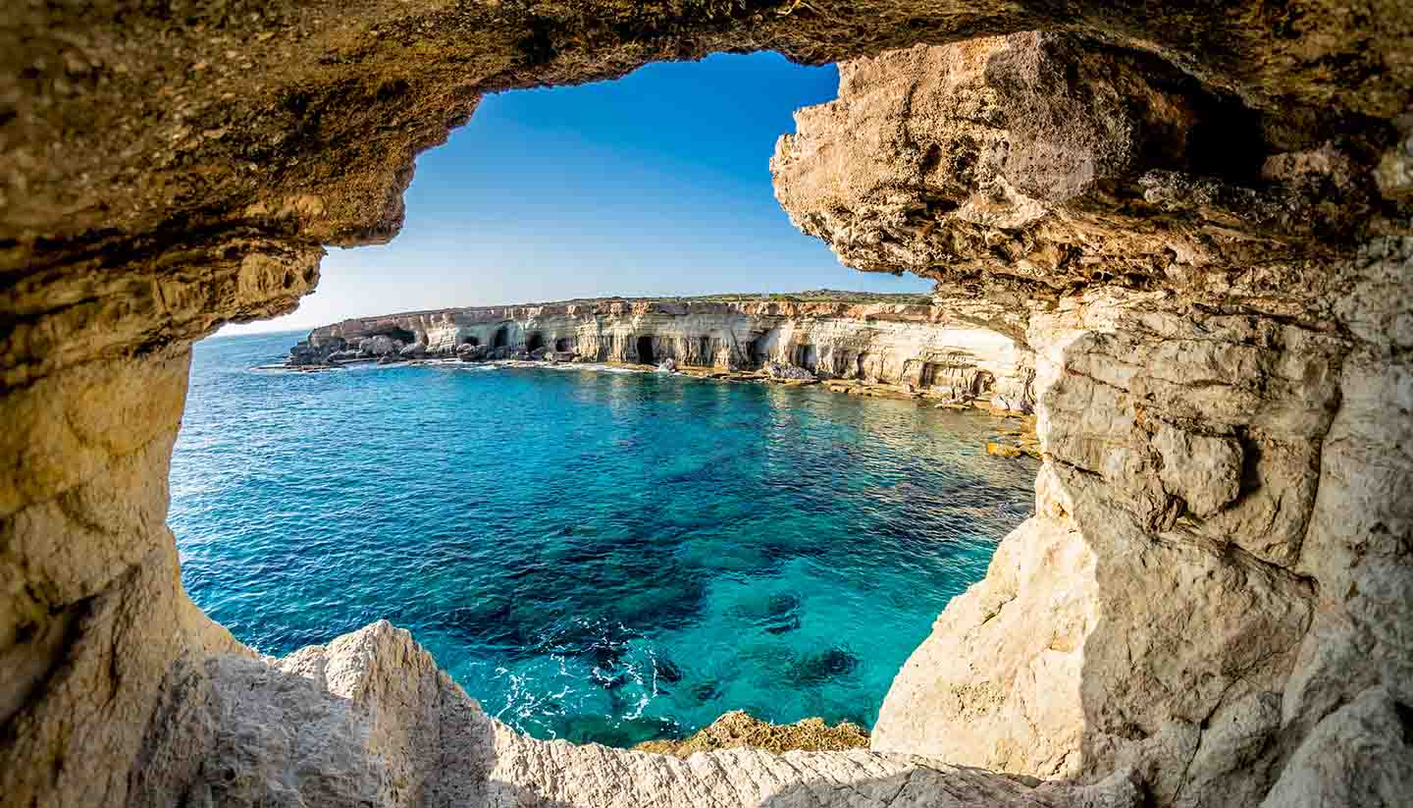
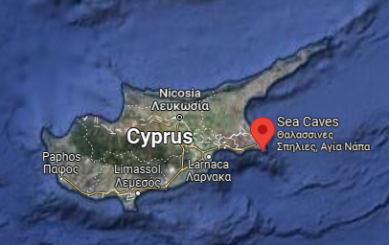
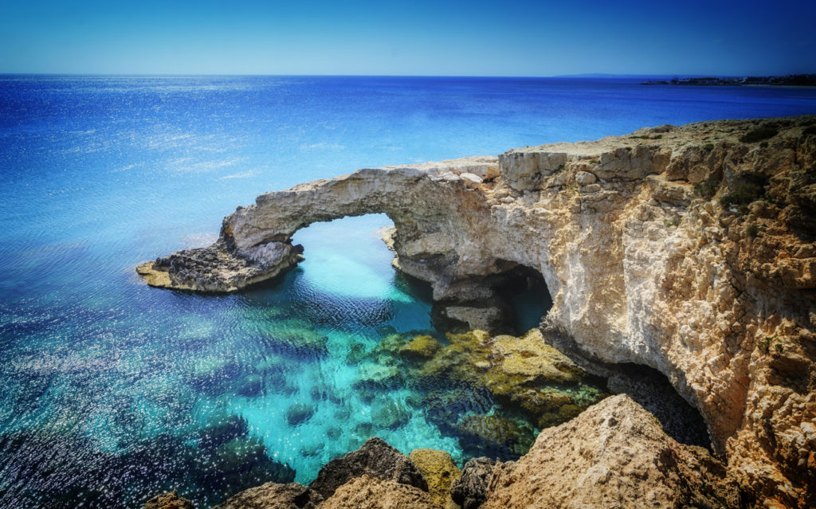
3. Cape Greco -sea caves & stone arches
Only a 1 hour and 10 minute drive from the capital
Cape Greco National Park houses magnificent sea caves and stone arches
There are multiple hiking routes in Cape Greco, including one that forms part of the European Long Distance Trail E4, running from Gibraltar to Cyprus.
The 2 kilometres Aphrodite nature trail which goes along the north east coast of the Cape Greco is part of the Aphrodite Cultural Route and commemorates the link with the goddess
Notes:
Cyprus Photos Nature – Bing
Cyprus Travel Guide: Discover a Rich Culture | Oliver's Travels (oliverstravels.com)
Ayia Napa Sea Caves | Cyprus Island
Cape Greco sea caves, Cyprus | Amazing World (wordpress.com)

Slide 9
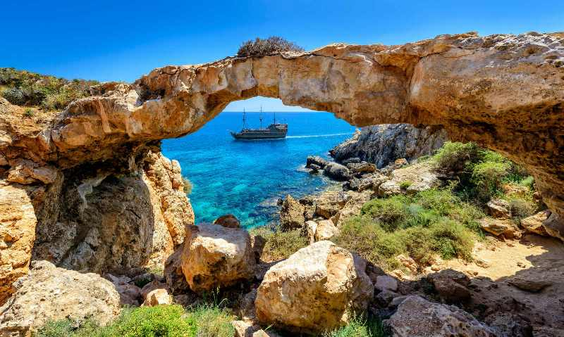
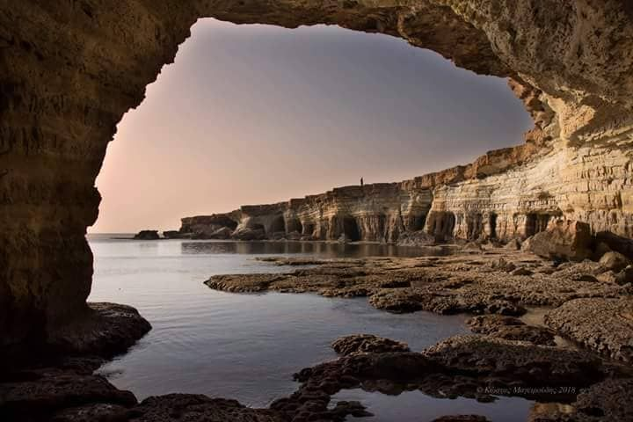
3. Cape Greco -sea caves & stone arches
Cape Greco covers an area of 385 hectares and was designated as a National Forest Park in 1993. Not only is it full of natural beauty, but the peninsula and forest park is also home to many animals, such as hares, foxes, and hedgehogs, and many species of birds and plants
However, the most famous “inhabitant” of the area is the “Ayia Napa Sea Monster”, which is believed to live in the sea caves!
Notes:
Cyprus Photos Nature – Bing
Cyprus Travel Guide: Discover a Rich Culture | Oliver's Travels (oliverstravels.com)
Ayia Napa Sea Caves | Cyprus Island
Cape Greco sea caves, Cyprus | Amazing World (wordpress.com)
agia napa sea caves geology - Bing images
Cape Greco in Cyprus - How to get there and more info for your visit (swedishnomad.com)

Slide 10
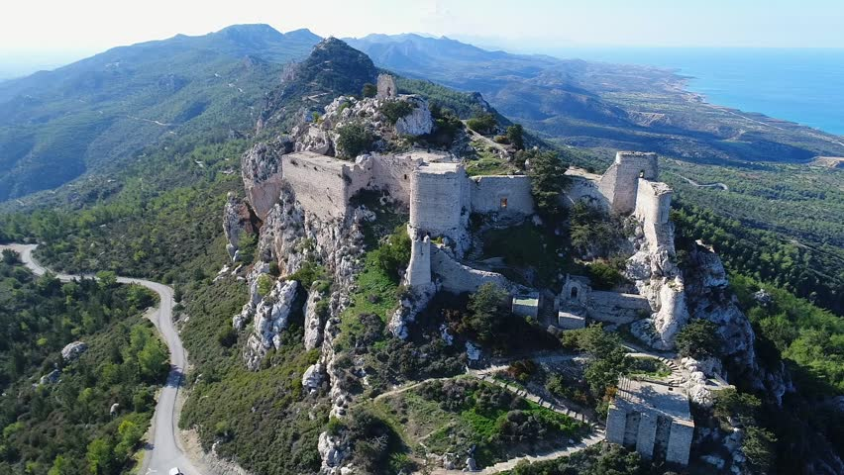
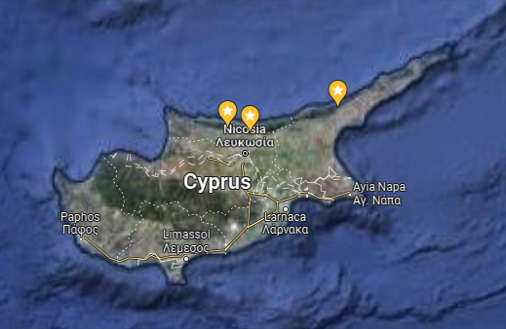
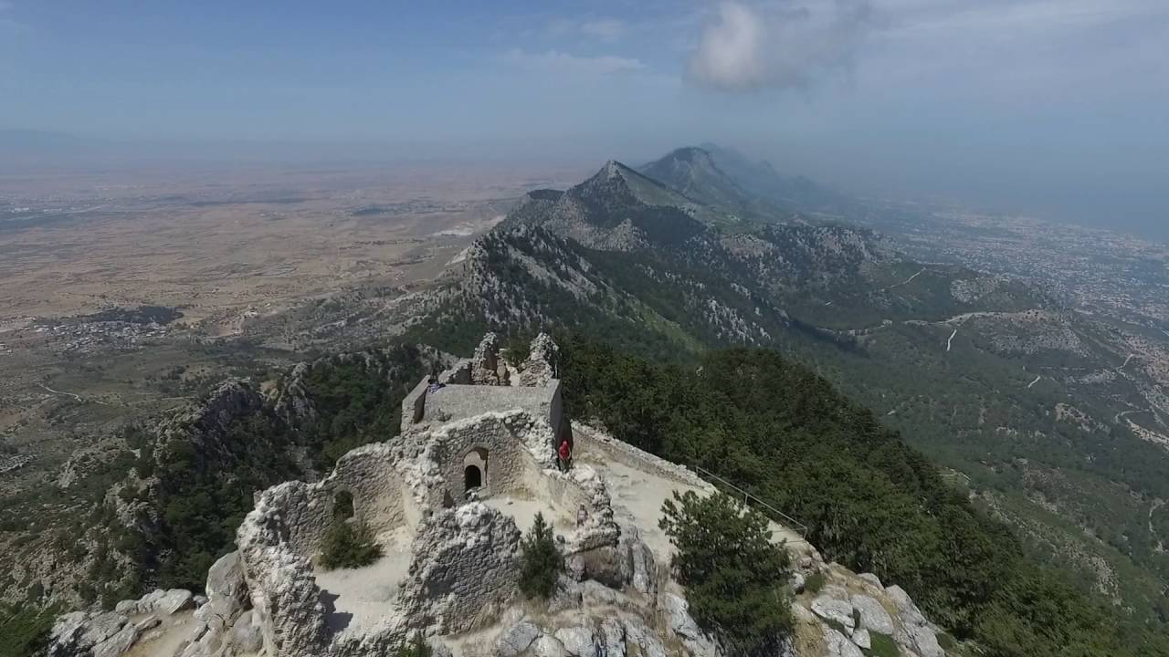
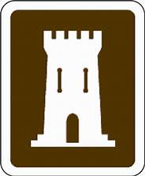
4. The Three Castles
The three castles built on the peaks of the Kyrenia Range are not only impressive historical remains; they also offer breathtaking views of the geology of the island.
The elevation of the castles allow great views of the dry Mesaoria plain at the central part of the island, contrasting to the humid and green slopes that run along the northern coast.
Saint Hilarion Castle
Buffavento Castle
Kantara Castle
Notes:
kantara castle - Bing images
buffavento castle – Bing
Buffavento Castle – Wikipedia
Kantara Castle – Wikipedia
Saint Hilarion Castle - Wikipedia

Slide 11
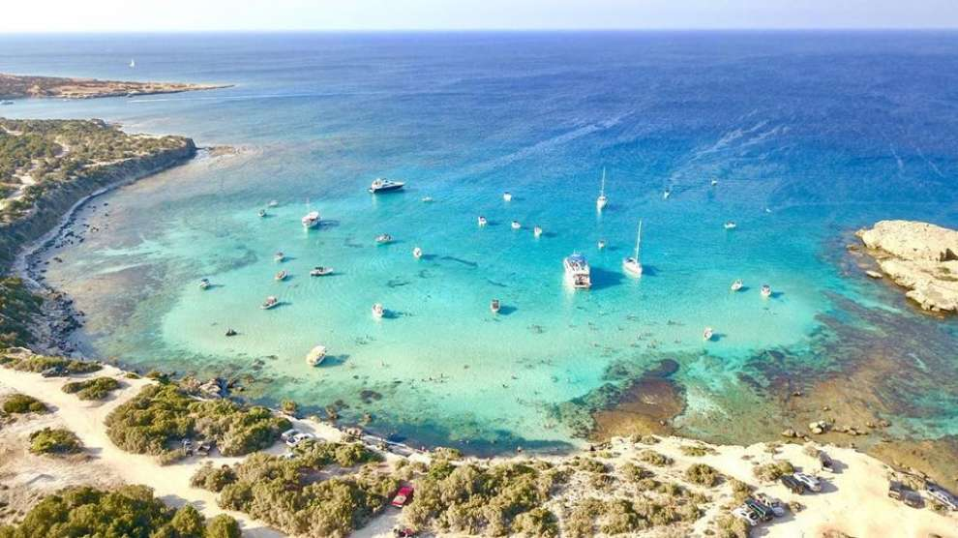
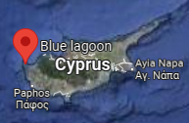
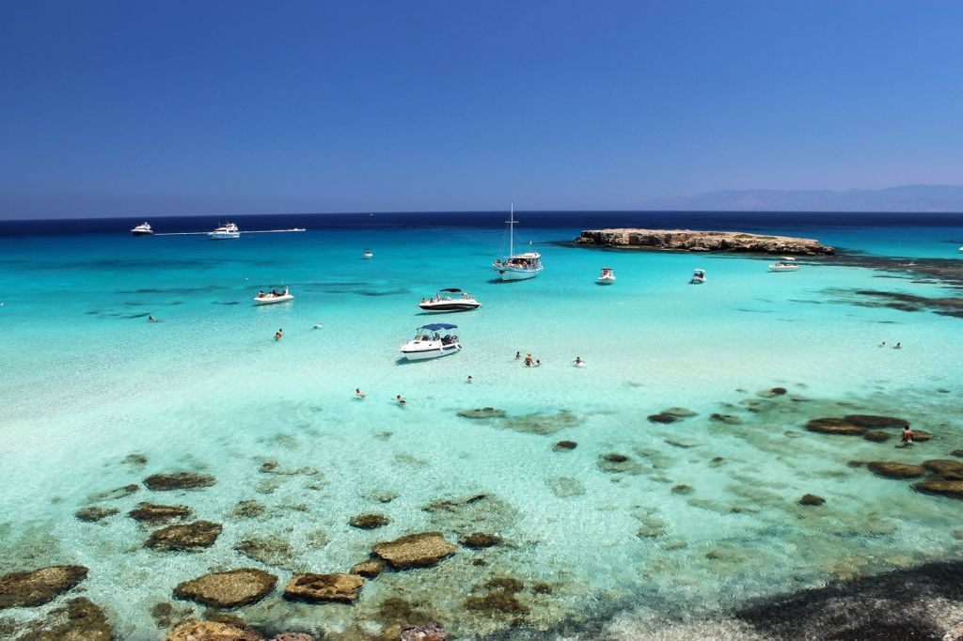
5. Blue Lagoon
Situated at the westernmost tip of Cyprus , Akamas Peninsula is included in the official UNESCO list of cultural and natural treasures of the world’s heritage
The blue lagoon beach is the largest bay in the Akamas region, where water is usually warmer than the rest of the area
It is a sandy and shallow bay, with clear azure waters and plenty of marine life to observe while snorkeling
Notes:
Photos of the Week (3/2012 - Week 3) - The Beauty of Cyprus - 1001Archives
blue lagoon akamas - Bing images
Akamas Peninsula - saving the jewel of Cyprus (anastasiagerali.blogspot.com)
Blue lagoon Beach, Akamas | Cyprus Island

Slide 12
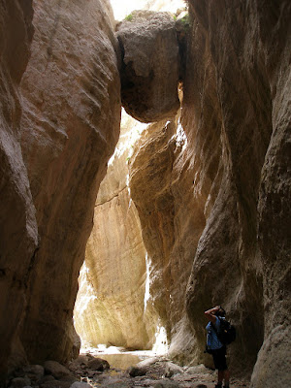
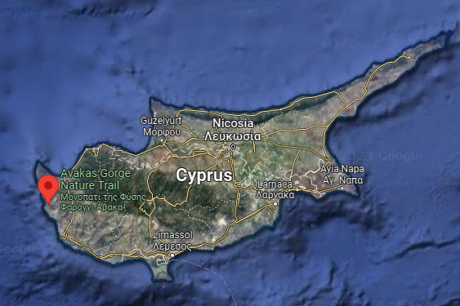
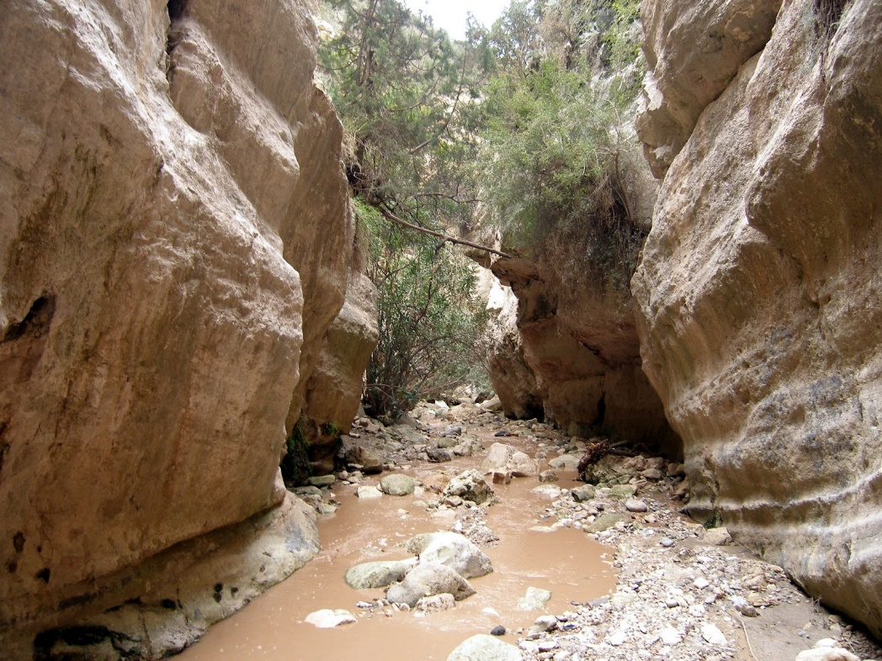
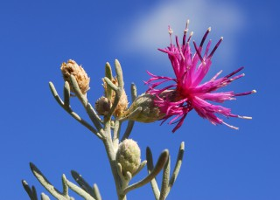
6. Avakas Gorge
The Avakas Gorge is a natural formation in Akamas peninsula that has been carved out of limestone rocks rising up 30 metres and winding along the stream that has eroded the rocks over thousands of years.
Avakas Gorge, and its two neighbouring gorges, are also the only places where the critically endangered endemic plant Centaurea akamantis can be found!
Centaurea akamantis
Notes:
Akamas Peninsula - saving the jewel of Cyprus (anastasiagerali.blogspot.com)
IUCN Top 50 - Centaurea akamantis (iucn-mpsg.org)

Slide 13
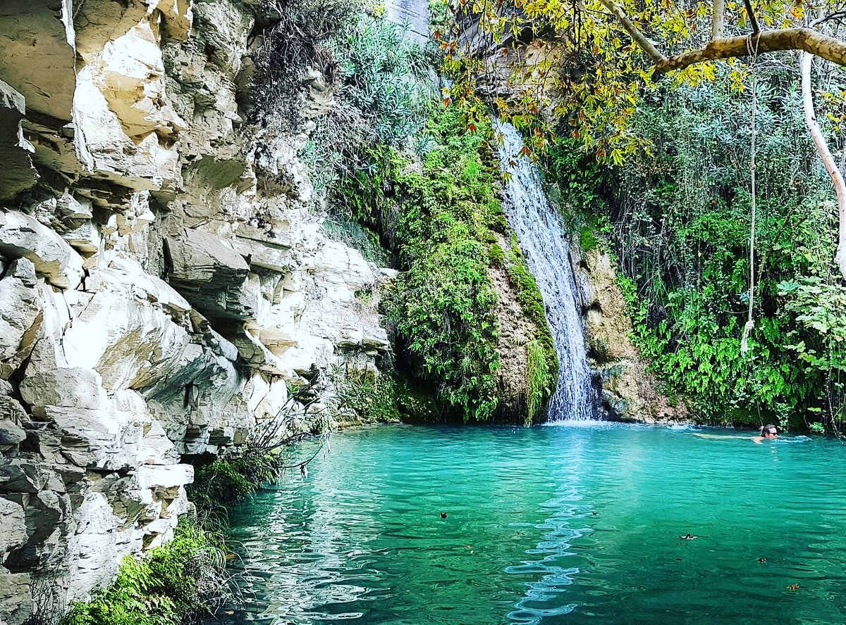
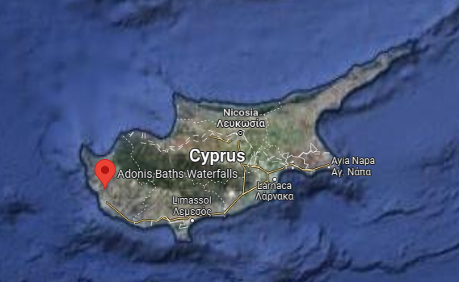
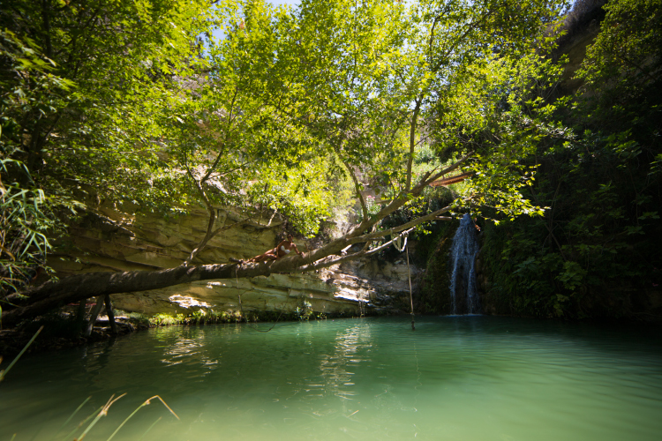
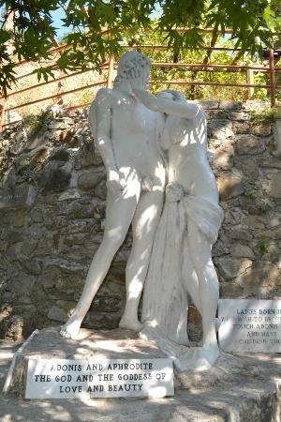
7. Adonis Falls
The Adonis Baths Waterfall is a natural waterfall and pond in a scenic and secluded location
According to Greek mythology, the god and goddess of love and beauty, Adonis and Aphrodite, spend most of their times here
A statue of the lovers welcomes the visitors to the baths
Notes:
adonis falls cyprus - Search (bing.com)
Adonis Baths & Waterfalls: The Hidden Oasis Near Paphos (thevivalavita.com)
Adonis Baths Waterfalls - Kili Village | Cyprus Island

Slide 14
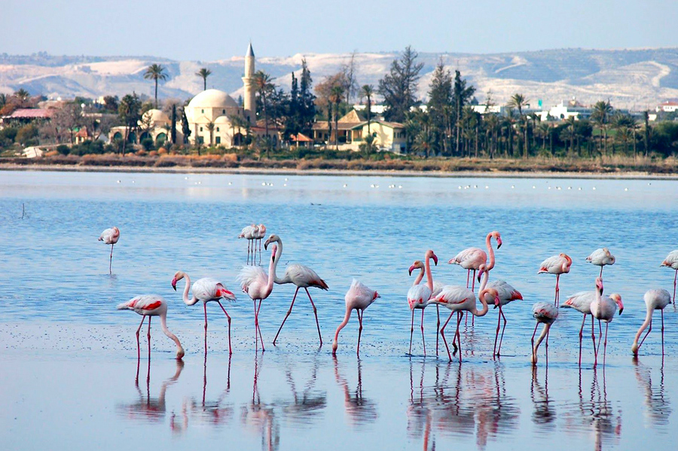
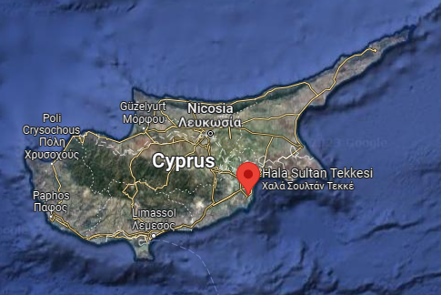
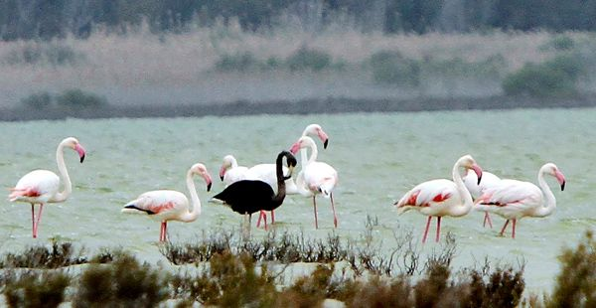
8. Salt lake
The second largest salt lake in Cyprus, the Larnaca Salt Lake is one of the most important habitats for waterfowl in Europe.
The salt lake was declared a protected area under Cypriot law and is a European Ramsar site, Natura 2000 site, a Special Protected Area under the Barcelona Convention, and an Important Bird Area (IBA).
The Hala Sultan Tekke overlooking the Salt Lake is considered to be one of the most important holy places of worship for Muslims
Notes:
larnaca salt lake black flamingo - Bing images
larnaca salt lake - Bing images
Visit the Larnaca Salt Lake: A Protected Habitat - My Cyprus Travel | Imagine. Explore. Discover.
Larnaca Salt Lake - Wikipedia

Slide 15
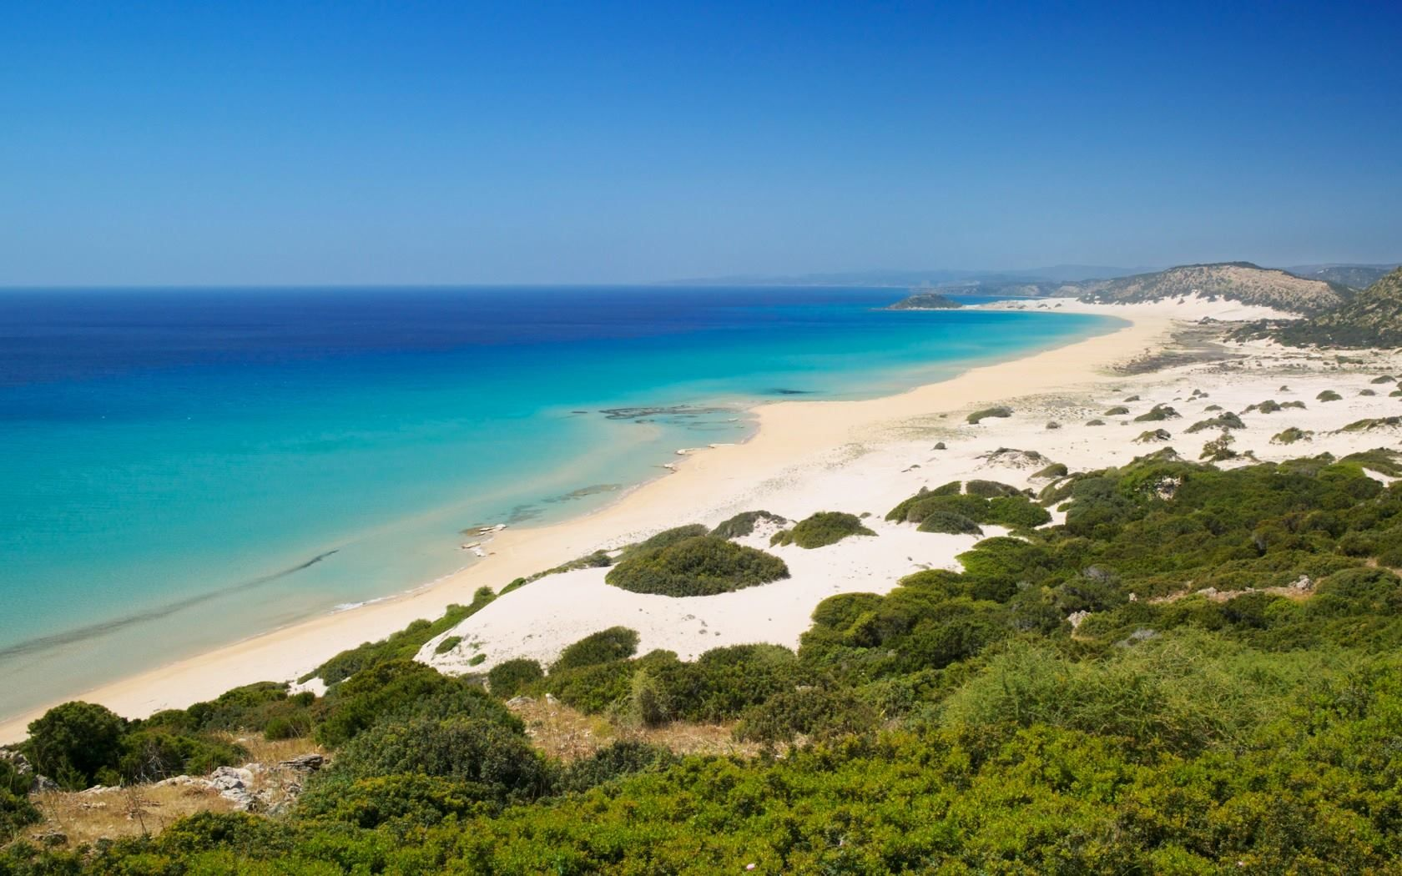
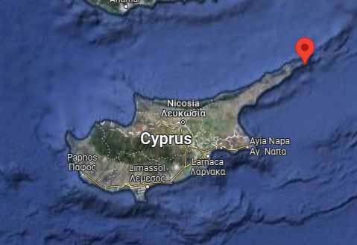
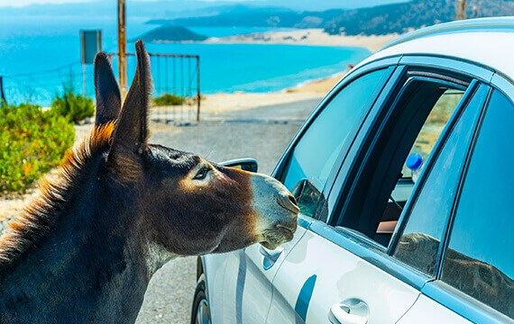
9. Karpaz Peninsula
Another heaven on earth can be found at the eastern tip of the island, at Karpaz peninsula, with its untouched natural beauty
The geology of the island offers kilometres of sandy beaches and sand dune formations adorned with maquis type vegetation
The tip of the peninsula is home to feral donkeys, that are admittedly sometimes too enthusiastic for snacks that tourists offer!
Notes:
kapraz peninsula cyprus donkey - Bing images

Slide 16
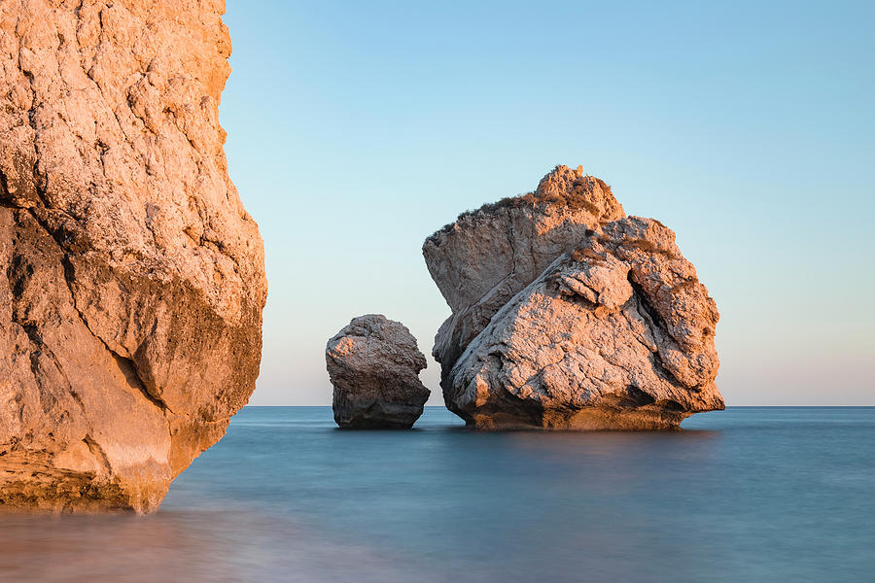
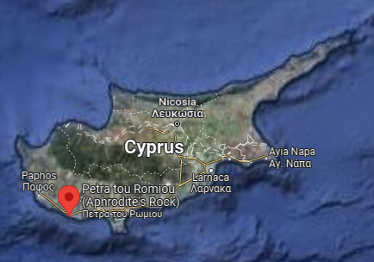
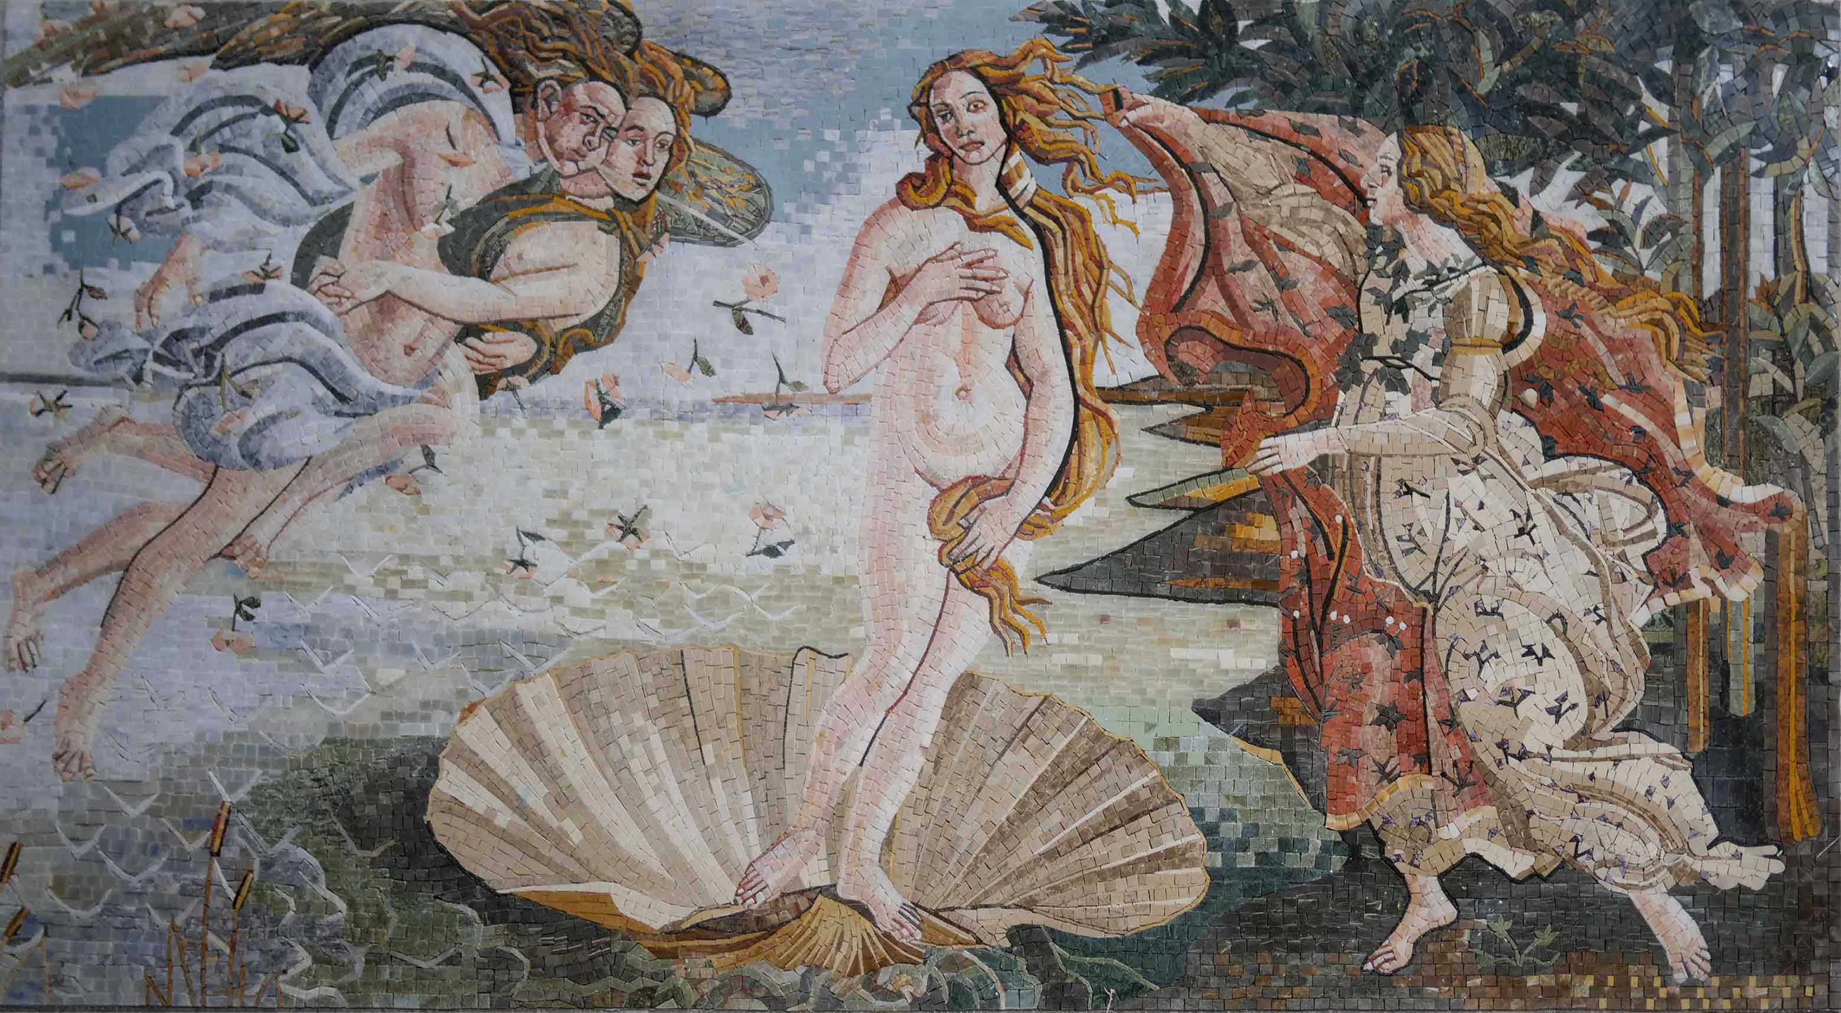
10. Petra tou Romiou
The “Roman rock” or “Aphrodite’s rock” is a sea stack in Paphos district
The sea is usually rough in this area, therefore it is advised to enjoy the beauty of the landscape from the coast
According to Greek mythology, this is the birthplace of Aphrodite, the goddess of love and beauty!
Notes:
birth of aphrodite painting - Bing images Sandro Botticelli
aphrodite cyprus - Bing images
Petra tou Romiou - Wikipedia

Slide 17
Practical Information
See you at the Troodos Geo Park to witness the “Oceanic whispers on high altitude”, and oceanic whispers throughout the rest of the island!
Most of the geo sites are at remote locations, inaccessible by public transport.
The best way to get around is to rent a car, but, keep in mind that we drive on the left!
Most of the geo sites are in remote areas with limited or no facilities, it is a good idea to have snacks, hydration, and sun protection in summer!
There are extensive networks of hiking trails around most of the geo sites, with various levels of difficulty.
The three castles and the Karpaz Peninsula are on the northern part of the island, requiring a border crossing. Border crossing is an easy process with a valid EU identity card/passport, and if you are crossing with a car, you also need to issue car insurance at the border. Two of the 8 crossing points are for pedestrians only, further information can be found at: CUSTOMS & EXCISE - Information for Passengers and Public - Crossing Points - Green Line Regulations (mof.gov.cy)

